Slide 1
Customer Creditworthiness Analysis
Project Report

Slide 2
Objective
Problem Statement
The objective of this machine learning project in the banking domain is to build a predictive model using historical banking data. The model aims to assist bank employees in efficiently and accurately determining suitable candidates for loan approval.
Develop a machine learning solution for the banking domain that automates and accelerates the loan approval process by effectively filtering and identifying suitable candidates from a high volume of loan applications. The current manual review process is time-consuming and inefficient, hindering the productivity of bank employees. By leveraging the available banking data, the goal is to create a model that accurately predicts the approval status of loan applications, enabling the bank to streamline operations, reduce processing time, and make more informed decisions regarding loan approvals.

Slide 3
Workflow
Domain study
Business impact
Model Evaluation
Data Quality Check
Parameter tuning,
Selecting the best model
Cleaning missing values and looking for irregularities
Model Building
Exploratory Data Analysis
Around the prepped data, we shall build a prediction model
Checking Hypothesis,
Feature Importance analysis

Slide 4
Business Impact
Improved Loan Approval Process
Operational Efficiency and Cost Savings
Compliance and Fraud Detection
Business Strategy and Decision Making

Slide 5
Data Dictionary
Loan_ID: Unique Loan ID issued on every loan for a applicant
Gender: Gender of a applicant whether male or female
Married: Marital status of a applicant i.e., Yes for married and NO for single
Dependents: Number of individuals who are financially dependent on applicant
Education: Highest Education of applicant i.e, Bachelor, Post Graduation etc
Self_employed: Whether the applicant is self employed or not i.e, Yes for self employed or else NO
Applicant Income: Income of the applicant
Co-Applicant Income: Applicant have to put one nominee name that is called Co-Applicant. So, it is column related to co-applicant income, dtype: Integer.
Loan Amount: Amount of loan applicant wants to issue from the bank.
Loan_Amount_Term: The amount of time the lender gives you to repay your whole loan, dtype: float.
Credit_History: It tells about the credit done in the past by the applicant, dtype: Integer.
Property_Area: This tells about the applicant property is in which area i.e., Rural or Urban, dtype: String.
Loan_status: It is a target variable column which tells about whether the applicant application for loan approval is passed or not, dtype: String.

Slide 6
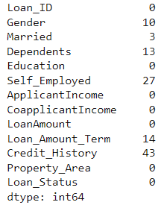
Knn Imputer
Data Cleaning
Number of missing values
Locate the missing values
Calculate the distance between each data
Select Nearest Neighbors
Calculate a weighted average of the values of the k nearest neighbors
This weighted average becomes the imputed value for the missing entry.

Slide 7
Assessing the Impact of every Feature on the Target Variable

Slide 8
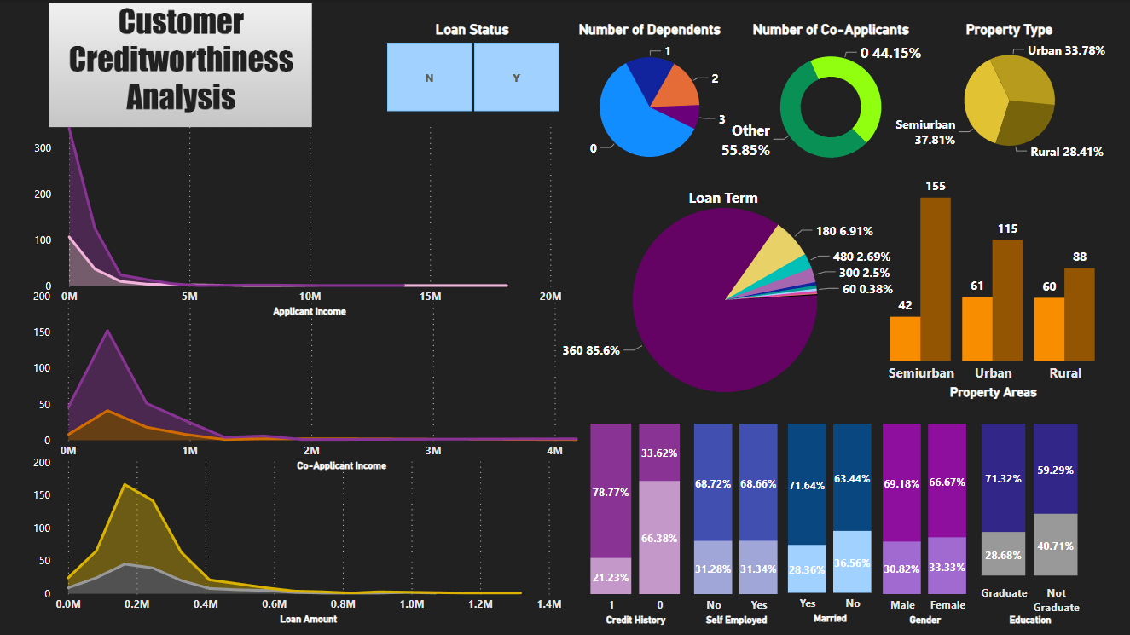
Key Insights

Slide 9
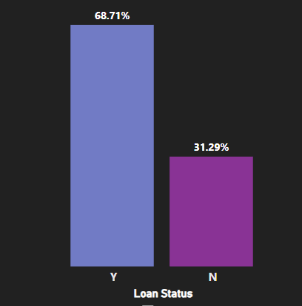
Loan Status
Approved Loans are almost 37% more than not approved loans

Slide 10
Inferences
Gender of the applicant does not impact the loan approval process
Chances of loan approval for married applicants are 7% more than unmarried applicants
There isn’t a conclusive difference in the loan approval for the number of dependents affecting the loan status.
In line with the hypothesis, graduates have higher percentage of approved loans than non graduates
The employment status (whether self employed or not) does not affect the loan status
Applicant income does not affect loan status directly
Chances of loan approval are slightly more with a co-applicant present
Applications with a lesser loan amount have more chance of approval
Acceptance rate of applications is more where term is less than 400 months
Applicants having a credit history have 45% more chance of having their loan approved
The Semi Urban property type applications have highest approval percentage for loans

Slide 11
MultiVariate
Analysis

Slide 12
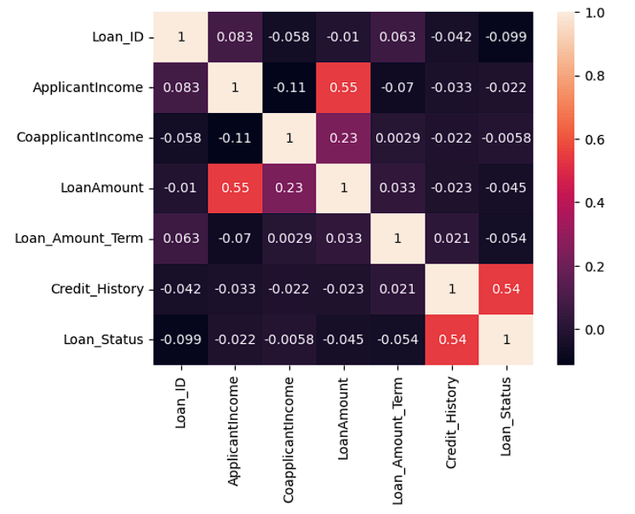
Applicant income is significantly positively correlated to the Loan Amount
Co-Applicant income is also slightly positively correlated to Loan Amount
Credit History is the only feature having direct and positive correlation with the Loan Status which is the Target variable

Slide 13
Data Preparation

Slide 14
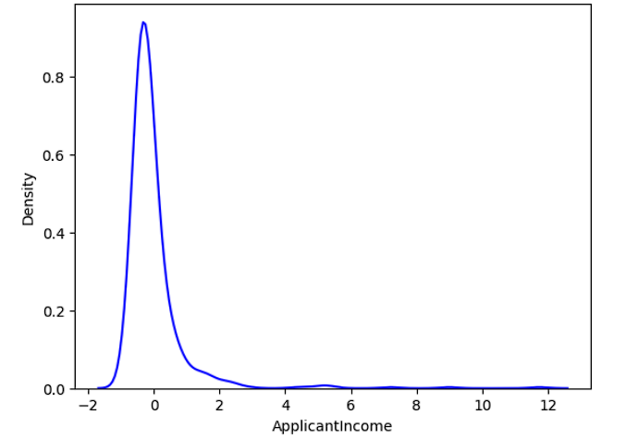
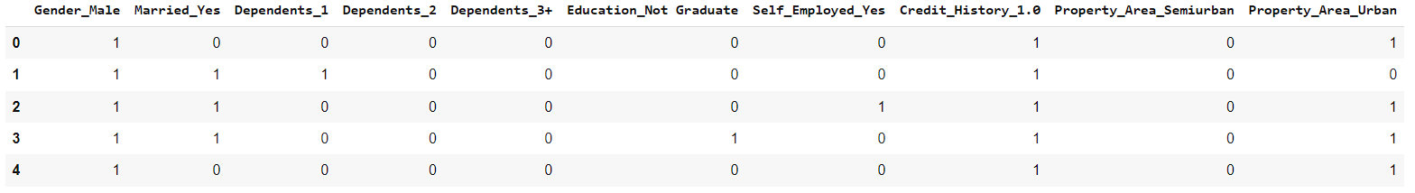
Data Prepping steps
Feature Scaling
Standardization for Numerical features having highly skewed data
One Hot Encoding
For Categorical features

Slide 15
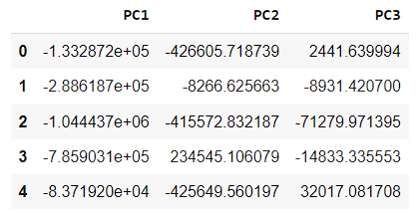
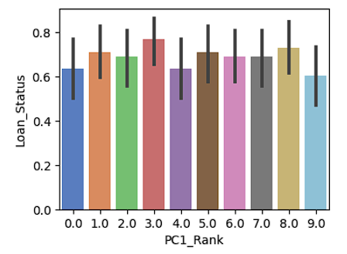
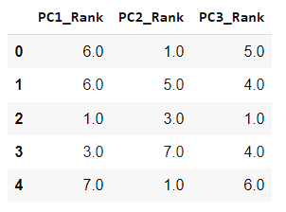
3. PCA
To remove any multicollinearity
4. Binning and
Discretization
Creating separate bins for continuous features
5. Feature Selection
Using K Best feature selector

Slide 16
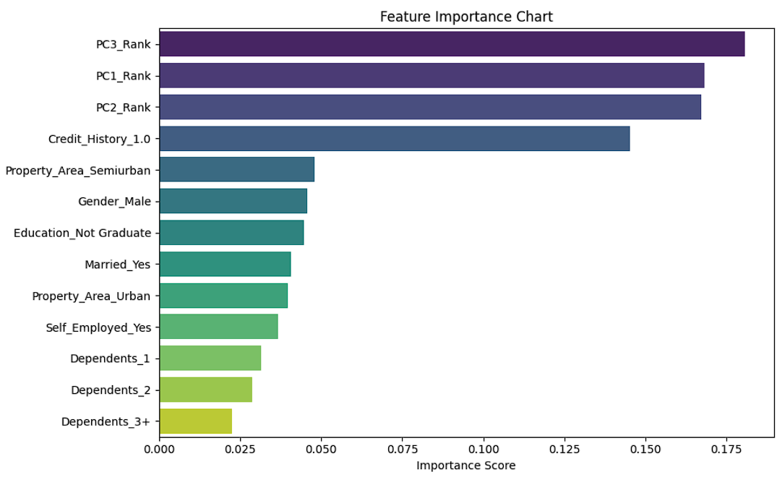
Feature Importance chart
Selected Features
by K Best Selector

Slide 17
Testing Models

Slide 18
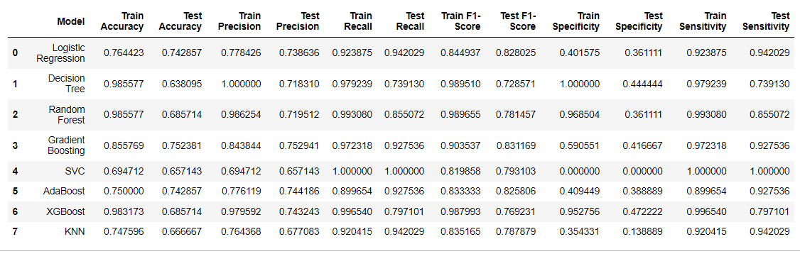
Metrics Before Tuning Models

Slide 19
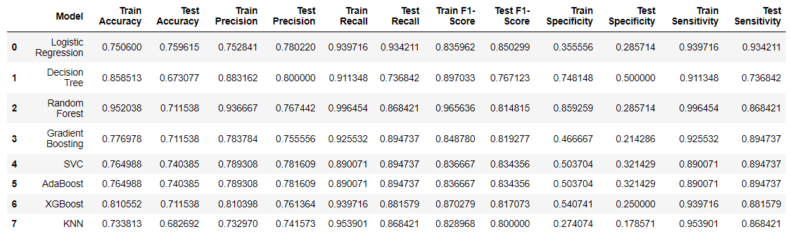
Metrics After Hyperparameter Tuning
Using Grid Search CV
High overfitting even after hyperparameter tuning
Models that have achieved a good balance between bias and variance

Slide 20
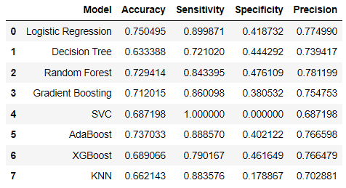
Average Metrics After K fold Cross Validation
The Average Accuracy of SVC with K fold decreases. Even if it had increased with hyperparameter tuning

Slide 21
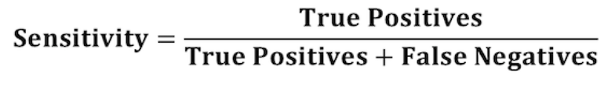



Sensitivity
Models With High Sensitivity
Accuracy
Sensitivity
What % of creditworthy loan applicants have correctly been identified to be creditworthy.
Such that we haven’t lost out on all these applicants
How well our model can detect positive instances

Slide 22
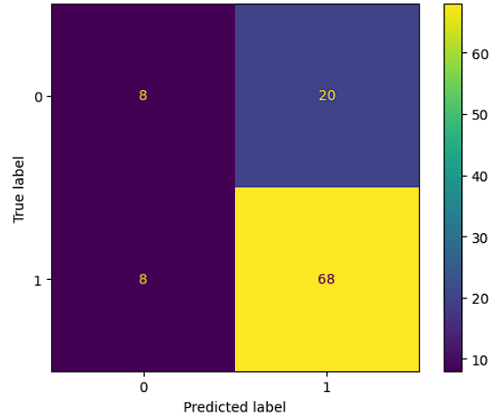
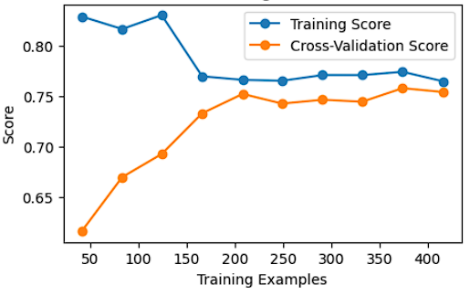
Logistic Regression
Accuracy
Sensitivity
Confusion Matrix
Both the training and cross-validation lines converge as the number of training examples increases, it indicates that the model is learning well from the data and has a good balance between bias and variance.
Learning Curve
Converging Curves
True Positives

Slide 23
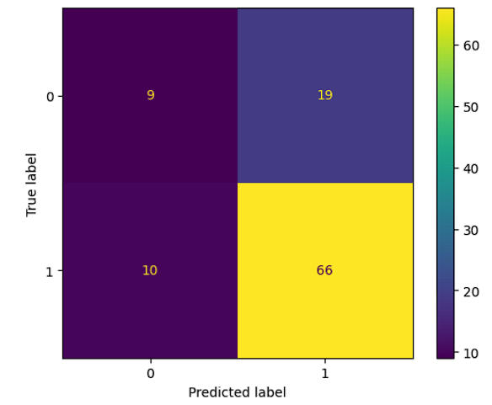
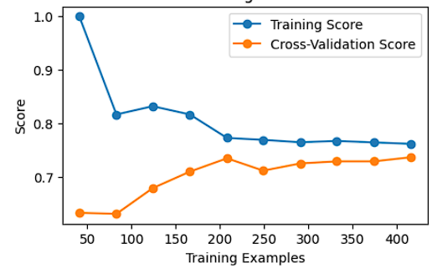
AdaBoost Classifier
Accuracy
Sensitivity
Confusion Matrix
Both the training and cross-validation lines converge as the number of training examples increases, it indicates that the model is learning well from the data and has a good balance between bias and variance.
Learning Curve
Converging Curves
True Positives

Slide 24
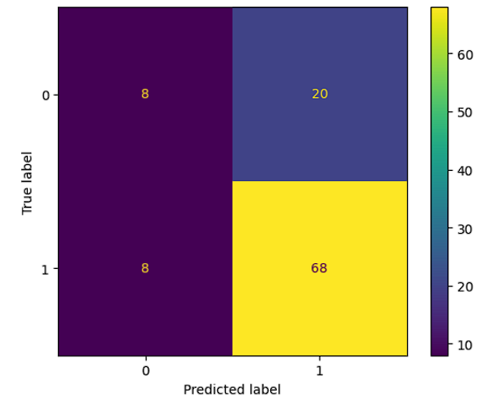
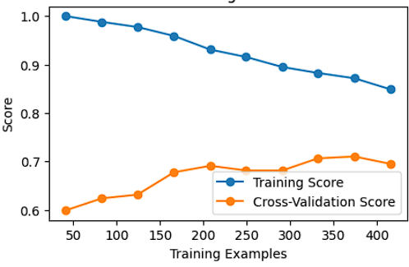
Gradient Boosting
Accuracy
Sensitivity
Confusion Matrix
The gap between the training and cross-validation lines, with the training score is significantly higher than the validation score, it suggests that the model has high variance and is overfitting. This means the model is too complex and is memorizing the training data.
Learning Curve
High variance
True Positives

Slide 25

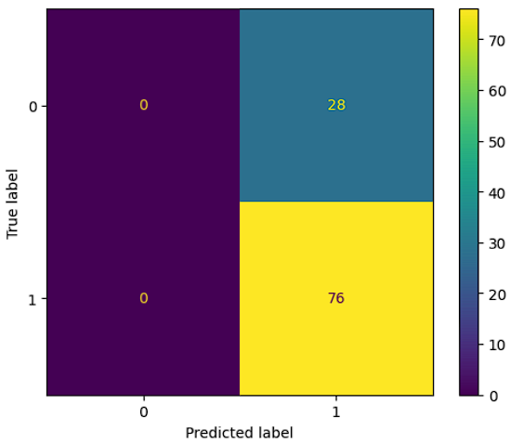
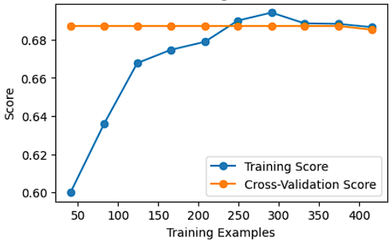
Support Vector Classifier
Accuracy
Sensitivity
Confusion Matrix
The model is highly convergent at a low accuracy, it indicates that the model is likely suffering from high bias, which can lead to underfitting. This observation seems to contrast with the accuracy improvement seen after hyperparameter tuning and the decrease in average accuracy after k-fold cross-validation.
Learning Curve
Converging Curves
False negative
True Positives

Slide 26
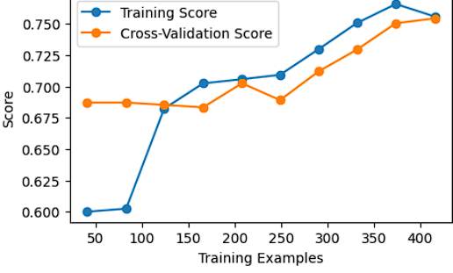
Conclusion
LOGISTIC REGRESSION
would be the best model for our data
Tuning the Hyperparameters further
Advantages over other models
Highest Accuracy amongst models
Highest Sensitivity amongst models
Good balance between Bias and Variance
Ability to differentiate Positives and Negatives
Comparatively most stable

Slide 27
Thank You

